Slide 1
DEPARTMENT OF BCA
FUNDAMENTALS OF MATHEMATICS
MODULE-1
MATRIX THEORY

Slide 2
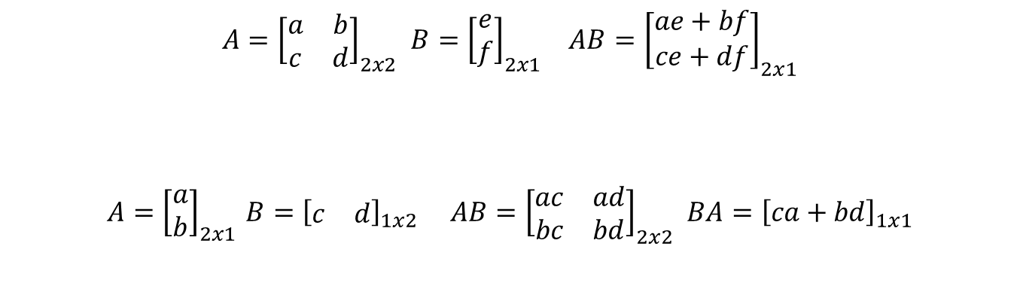
MULTIPLICATION OF MATRICES
DEFINITION: When the number of columns of the first matrix is the same as the number of rows in the second matrix then matrix multiplication can be performed.
Here is an example of matrix multiplication for two 2×2 matrices.
$$\begin{matrix}\begin{aligned}\begin{aligned}\begin{aligned}A={\left[\begin{matrix}a & b \\ c & d\end{matrix}\right]}_{2x2} B={\left[\begin{matrix}e \\ f\end{matrix}\right]}_{2x1} AB={\left[\begin{matrix}ae+bf \\ ce+df\end{matrix}\right]}_{2x1} \\ \end{aligned} \\ \end{aligned} \\ \end{aligned} \\ \\ A={\left[\begin{matrix}a \\ b\end{matrix}\right]}_{2x1} B={\left[\begin{matrix}c & d\end{matrix}\right]}_{1x2} AB={\left[\begin{matrix}ac & ad \\ bc & bd\end{matrix}\right]}_{2x2} BA={\left[ca+bd\right]}_{1x1}\end{matrix}$$

Slide 3

MULTIPLICATION OF MATRICES
Here is an example of matrix multiplication for two 3×3 matrices.
$$\begin{matrix}\begin{aligned}\begin{aligned}A={\left[\begin{matrix}a & b & c \\ d & e & f \\ g & h & i\end{matrix}\right]}_{3x3} B={\left[\begin{matrix}j & k & l \\ m & n & o \\ p & q & r\end{matrix}\right]}_{3x3} \\ \end{aligned} \\ \end{aligned} \\ AB={\left[\begin{matrix}aj+bm+cp & ak+bn+cq & al+bo+cr \\ dj+em+fq & dk+en+fq & dl+eo+fr \\ gj+hm+ip & gk+hn+iq & gl+ho+ir\end{matrix}\right]}_{3x3}\end{matrix}$$

Slide 4
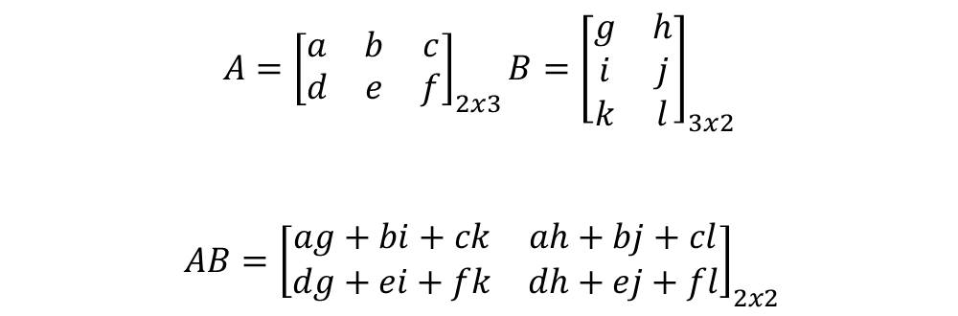
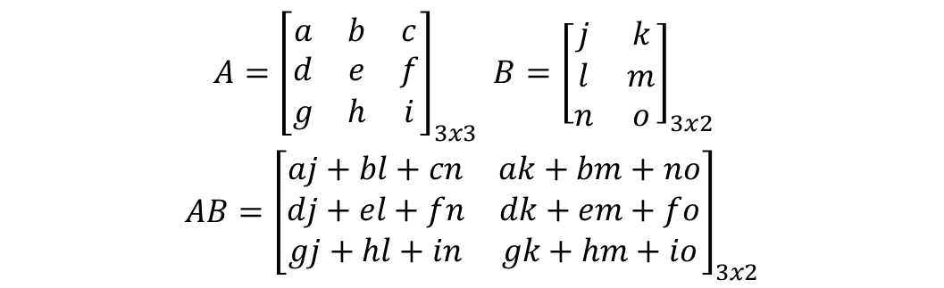
MULTIPLICATION OF MATRICES
$$\begin{matrix}A={\left[\begin{matrix}a & b & c \\ d & e & f \\ g & h & i\end{matrix}\right]}_{3x3} B={\left[\begin{matrix}j & k \\ l & m \\ n & o\end{matrix}\right]}_{3x2} \\ AB={\left[\begin{matrix}aj+bl+cn & ak+bm+no \\ dj+el+fn & dk+em+fo \\ gj+hl+in & gk+hm+io\end{matrix}\right]}_{3x2}\end{matrix}$$
$$A={\left[\begin{matrix}a & b & c \\ d & e & f\end{matrix}\right]}_{2x3}\text{​​}B={\left[\begin{matrix}g & h \\ i & j \\ k & l\end{matrix}\right]}_{3x2}$$
$$AB={\left[\begin{matrix}ag+bi+ck & ah+bj+cl \\ dg+ei+fk & dh+ej+fl\end{matrix}\right]}_{2x2}$$

Slide 5

MULTIPLICATION OF MATRICES
Example:
1.
2.

Slide 6
TRANSPOSE OF MATRICES
DEFINITION: The transpose of a matrix is found by exchanging rows for columns i.e. Matrix A = (a_{ij}) and the transpose of A is:
A^{T} = (a_{ji}) where j is the column number and i is the row number of matrix A.
For example, the transpose of a matrix would be:

Slide 7
PROBLEMS
1. A= and B =
2. A = and B =
3. A = and B =
4. A = and B =

Slide 8
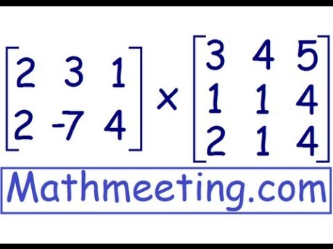

Slide 9
THANK YOU

